Slide 1


2019/2020 TR2019/2020 2025-2026 Year-end Training Q&A
___________________________ Business and Administrative Services

Slide 2
Introduction
Heather Macaulay, AVP of Business and Financial Services, and Chief Accounting Officer
Liz Gamez, Director of Accounting and Reporting, Campus
Natasha Hayes, Assistant Vice President and Chief Budget Officer
Rosalba Flores, Director of Budgeting and Accounting, Sponsored Programs
Jassica Gauna, Director of Budgeting and Accounting, University Advancement, Office of the President and Business Partners
Elizabeth Walker, Director of Budgeting and Accounting, Student Affairs and Athletics
Hillary Castellano, Director of Accounting and Reporting, Payment Services
Lucero San, Position Control Analyst
Marina Manzano, Chief Procurement Officer
Leslea Hanssen, Director of Accounting and Reporting, Student Financial Services

Slide 3
Campus Accounting & Reporting Services
Year End Deadlines to Remember
Campus Expenditure Transfers
May 4, 2026 – Last day to submit transfers for all transactions through April 2026.
June 4, 2026 – Last day to submit transfers for May 2026 transactions.
No expenditure transfers for June, these must be corrected at the time transaction is being processed.
Chargeback Processing
Chargebacks processed are typically one month in arrears.
FY25/26 chargebacks will be for services from June to May.
Deadline for service providers to submit for chargebacks: June 1st.
June 2026 chargebacks will be processed and posted in next fiscal year.
Contact:
Liz Gamez - accounting@csub.edu

Slide 4
Campus Accounting & Reporting Services
BKCMP Expenditure Transfer Tips
Email accounting@csub.edu with attached Excel JE form.
Include supporting documentation to support amounts on the transfer.
Procard reconciliations, invoices, receipts, or Datawarehouse reports.
Provide detailed explanation and justification for the transfer in the Justification box.
Include proper description on each line of journal entry. Also use reference column for additional information.
Use the same description as shown on Datawarehouse.
Include authorized signatures.
Approval must be obtained from the Department accepting the expenditure transfer.
Include name of approver.
For all transfers involving Hospitality expenses, include Hospitality justification form, list of attendees, and flyer or documentation on event.
Contact:
Liz Gamez - accounting@csub.edu

Slide 5
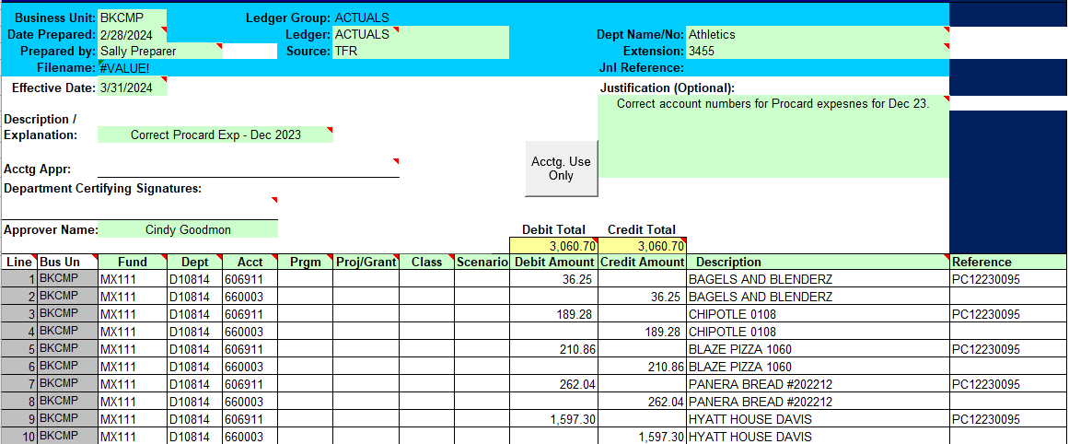
Campus Accounting & Reporting Services
BKCMP Expenditure Transfer Sample
Contact:
Liz Gamez - accounting@csub.edu

Slide 6
Campus Accounting & Reporting Services
Miscellaneous Department Revenues
Please contact our office if any of the following applies to revenues received/deposited into trust funds (MX funds):
Revenues received for services provided to general public or external parties
Revenues received for services that are not related to a CSUB course and do not involve student volunteer work.
Revenues received for rental of facilities/equipment to general public or external parties.
Revenues or commissions from sales of items to general public or alumni.
Revenues from sponsorship agreements.
Revenues are received on a regular basis (i.e weekly, monthly or quarterly).
If these apply, please do the following:
Contact Adam Bye, Accountant III, ext. 2205, abye@csub.edu.
Proper account codes will be provided.
Departments will be notified of any tax implications.
Update Trust Agreement form to include new sources of funds.
Contact:
Liz Gamez - accounting@csub.edu

Slide 7
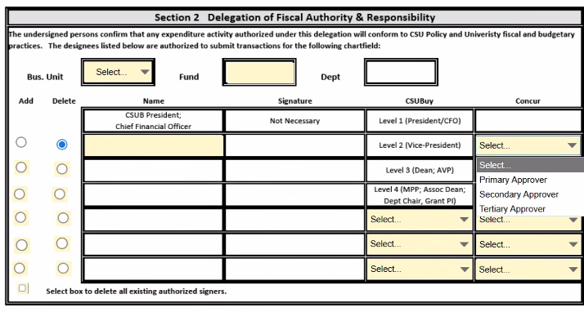
Campus Accounting & Reporting Services
Delegation of Authority Updates
Updates to Delegation of Authority & Chartfield Request Form
Two Approval Columns
CSUBuy System
Levels 1 through 4
Multiple Approvers allowed in each level
Concur System
Three sequential approvers: Primary, Secondary, Tertiary.
Minimum: Primary Approver
Multiple approvers for each approver type are not allowed.
Contact:
Liz Gamez - accounting@csub.edu

Slide 8
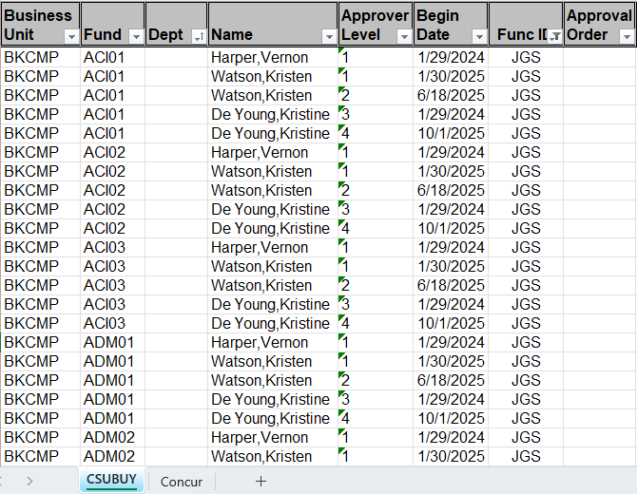
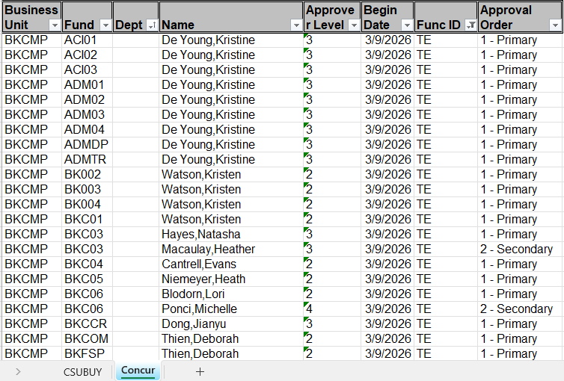
Campus Accounting & Reporting Services
Delegation of Authority Updates
New format to Delegation of Authority file in BOX
CSUBuy DOA – Approver Levels
Concur DOA – Approval Order
Contact:
Liz Gamez - accounting@csub.edu

Slide 9
Budget Office
FY 2025-26 Budget Transfers
Final day to submit Friday, June 12, 2026
Questions??
ORG-Budget@csub.edu
Contact:
Natasha Hayes - ORG-Budget@csub.edu

Slide 10
Sponsored Programs Post Award
SPA Grants
Deadline to turn in all SPA FY 2025-26 invoices to SPA Accounting is noon on July 7, 2026.
SPA Accounting will manually accrue all FY 2025-26 invoices submitted to Post Award by on noon on July 7, 2026. (All grant-related paperwork is due in Post Award by
July 02, 2026) Please be sure to submit your paperwork to you assigned grant analyst.
Manual accrual list must be submitted to the Grants Accountant for all individual FY 2025-26 invoices greater than $100 that were not submitted to Post Award by July 2nd deadline.
Note: To avoid a duplication, invoices submitted to Post Award for payment should not be on the June accrual list.
Contact Gipsy Meja at x 2875 or Frank Pacheco at x2476 with any questions
Contact:
Rosalba Flores– spaaccounting@csub.edu

Slide 11
Sponsored Programs Post Award
IMPORTANT REMINDERS
Equipment or Inventory Purchases Close to Year-End
Allow sufficient time for:
Vendor to ship items
Procurement receive/tag items
Reviewing transactions/identifying expenses belonging to other business units
Expense transfers or payroll moves to BK001 -Must meet campus deadlines
Grant Analyst Contacts:
Alisia Gonzalez (Valenzuela)– avalenzuela@csub.edu
Eidie Gonzalez– egonzalez184@csub.edu
Silvia Lozano Cuesta– slozano@csub.edu
Maria Avila– mavila15@csub.edu

Slide 12
Foundation
Deposits to BKFDN
All deposits (checks, cash, credit cards) for BKFDN are handled by the University Advancement gift processor for proper recording, document retention, and tax receipting
Drop off to UA or contact for pick up
Include note or documentation on the nature of the payment and the fund(s) to be credited
One-time administrative fee of 5% is required on all fundraising activities (i.e., donations, sponsorships, ticket sales, and auction purchases)
Org Inbox Contact: foundationaccounting@csub.edu
Contact:
Jassica Gauna- jgauna@csub.edu

Slide 13
Foundation
Gift-in-Kind Acceptance
Non-cash donations (i.e. goods, equipment, property, services)
GIK form must be submitted and approved by Foundation Executive Director before accepting and receiving the gift
Memo to campus with additional information
Fundraising Events Sponsorships
Fundraising event approval form required per CSU policy. Memo available with additional information
Sponsorship packets must be reviewed by UA Accounting to evaluate benefits provided to sponsors for tax deductibility
CSUB Foundation does not hold raffles due to State and IRS regulations and filing requirements
Contact:
Jassica Gauna- jgauna@csub.edu

Slide 14
SASEM
Instructional Related Activities-MSI01 (IRA)
Travel Deadlines
Concur FY 25/26 travel claims through April 30, 2026 must be submitted by May 29, 2026.
Travel Accruals for travel from May 1- June 30, 2026 must be submitted by June 1, 2026.
Journal Entries
April expense transfers must be submitted by May 4, 2026.
May expense transfers must be submitted by June 4, 2026
No additional expense transfers will be processed following June 4, 2026, including Procard transactions related to an IRA activity but posted to a non-IRA fund.
Once deadlines pass, unique project codes will be deactivated and will not be able to be used.
Please ensure all expenses are in alignment with approved grant requests.
Contact:
Elizabeth Walker – ewalker17@gmail.com

Slide 15
Payment Services
All communication should be submitted to accounts_payable@csub.edu
May 1: Direct Pays and invoices through April 30th are due
May 13: All paper FY 25/26 travel claims for travel occurring before April 1, 2026
Paper travel claims will not be accepted for travel occurring after April 1st.
May 29: All Concur FY 25/26 travel claims for travel occurring through April 30, 2026
June 1: May AP paperwork due
June 1: Accruals for travel due. A FY25-26 Travel Accrual PowerForm must be submitted.*
June 4: All FY24/25 AP paperwork due
*No travel ending before April 6, 2026 will be accrued because CSU policy requires travel claims to be submitted no later than 60 days after the end of travel. Please accrue only out of pocket expenditures as any Concur credit card charges will be accrued on our end.

Slide 16
Payment Services
Note:
Paperwork received after the deadlines may not be accrued or paid before year-end.
If you submit a travel claim before June 30th that was submitted on a Travel Accrual Form, please note that prominently on the claim & attach a copy of the accrual form as the first page of the travel claim.
Contact:
Hillary Castellano
hcastellano@csub.edu

Slide 17
Payment Services
Procurement Card (ProCard)
The ProCard billing cycle for June is May 12 through June 10, 2026.
The reconciliation period in PeopleSoft for the June statement is June 11 through June 24, 2026 (7 business days).
Please Note:
When the reconciliation period ends, the charges for June will be final. They cannot be transferred before year-end and cannot be transferred in the following year.
Use tax chargebacks for purchases made in the June 2026 billing cycle will be posted to the FY 2026-27 budget.
Contact:
Hillary Castellano
hcastellano@csub.edu

Slide 18
Labor Cost Distribution (LCD)
Please refer to the year-end memo for specific deadlines.
All Payroll Move Request and PCAR forms with grant related funding must be submitted to Post Award (previously known as GRASP) for review and approval prior to sending to HR.
REMINDER: Any payroll moves into BK001 must be submitted by May 1, 2026.
Additional Assistance / Q&A Opportunities
Labor Cost Distribution (LCD) User Support Group
Contact Lucero San to be added to the group
LCD/PC Open Lab session (via Zoom)
Invitation will be sent out in May for June 12th
Contacts:
Human Resources – hr@csub.edu | Tina Williams – twilliams@csub.edu | Lucero San – lsan1@csub.edu

Slide 19
Payroll
All monthly June Payroll dated on or before July 1, 2026
will be charged to FY 2025-26 budget.
Employees that are paid for month of June on July 13, 2026
will be charged to the FY 2026-27 budget
(this includes prior pay period late time).
Hourly and Special Consultant Payroll for Grant programs ending June 30, 2026
must be submitted to HR/Payroll by June 12, 2026 for these transactions to be charged to FY 2025-26.
Contacts:
Human Resources – hr@csub.edu | Tina Williams – twilliams@csub.edu Patrice Baker – pbaker@csub.edu

Slide 20
Procurement and Contract Services
CRITICAL DEADLINES
May 7, 2026
Requisitions $25,000 and greater, including Public Works projects, must be submitted in CSUBUY Procure-to-Pay (P2P) with required approvals.
May 28, 2026
Requisitions less than $25,000 must be submitted in CSUBUY Procure-to-Pay (P2P) with required approvals.
Note: Any requisitions not meeting the above due dates will be held for processing in FY 2026-27.
Procurement cannot guarantee any requisitions submitted by the due date will be processed in current FY if additional approvals are needed or processes required, such as contract creation or bid process.

Slide 21
Procurement and Contract Services
FY 2026-2027 Requisitions
Requisitions for the new FY may be submitted in CSUBUY P2P as of May 1 (do not submit before this date). Please be sure to input an Accounting Date of 7/1/2026 and add a comment that PO is for “FY 2026-27.”
Any POs processed after 5/2 will be held for release until 7/3 unless there is a critical need to release early, contact Procurement to discuss.
All requisitions submitted on or after June 1 will go to Procurement for processing, including punchout catalog items (i.e. Staples, Amazon) that are low risk and low dollar that normally would not go through Procurement.
Contact: Procurement@csub.edu

Slide 22
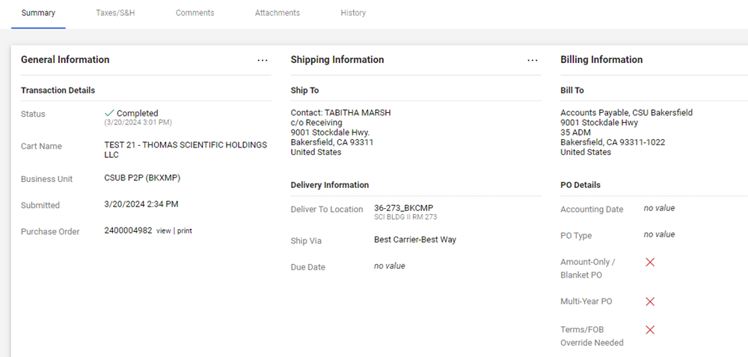

Slide 23
Procurement and Contract Services
Annual Renewals and Blanket Purchase Orders
Annual renewals and blanket PO requisitions can be submitted on or after Friday, May 1, 2026 with an Accounting Date of 7/1/26 or later and a comment that PO is a blanket or annual renewal for FY 2026-27.
On or after July 1, the accounting date and comment is no longer necessary.
CSUBUY P2P provides visibility to requestors for all requisitions submitted and the search functionality is simple and easy to use, therefore, Procurement will no longer provide a listing of all campus blankets and annual renewals.
For blanket POs that are a combination of goods and services, please be sure to create at least two lines, one for taxable goods and one for non-taxable services.
Contact: Procurement@csub.edu

Slide 24
Student Financial Services
University Centralized Billing
The CO has mandated that University billing be centralized (non-student).
All third-party billing, including billing to any Auxiliary, has to be processed by the University Accounts Receivable (AR) Accountant.
Preferred Contact:
University Accounts Receivable: accounts_receivable@csub.edu
A staff member will respond within 2 business days.
Cash Collection Sheet - Change in Support Required
Please provide all support related to the cash receipts (i.e., Invoices, receipts, deposit slips, customer correspondence, etc.)
A copy of the check is not needed as an attachment
Contact:
SFS AR Email- accounts_receivable@csub.edu

Slide 25
Student Financial Services
AR CRITICAL DATES TO REMEMBER
May 4th - All Billing Request Forms through 4/30/2026 are due from departments.
June 4th - All Billing Request Forms through 5/31/2026 are due from departments.
June 4th - All Billing Request Forms for the month of June 2026 are due from departments.
June 4th - Petty Cash activity through 6/4/2026 are due to the Cashier’s Office.
Deposits & Petty Cash Heleyna Jacquez.........6206
Accounts Receivable (Off Campus) Valeria Rodriguez.......3975
Accounts Receivable (Student & On Campus) Christina Orozco.........3225
Contact:
SFS AR Email- accounts_receivable@csub.edu Cashiering Office- cashiersoffice@csub.edu

Slide 26
Student Financial Services
25LIVE TRANSACTIONS –
REMINDER –
All on and off-campus events MUST be entered into 25Live two weeks in advance of the event.
All events must adhere to the CSUB Use of University Property and Time, Place and Manner Policy.
University-sponsored event taking place off university property must be entered into 25Live using the “OFF CAMPUS” location.
June 2nd Deadline: All on and off-campus events through June 1, 2026 must be sealed in 25Live.

Slide 27
Journal Entries and Expense Transfers
Journal entries including expense transfers should be sent to the following departments whose business unit is initiating the journal entry and/or expense transfer:
BKCMP – Liz Gamez or accounting@csub.edu
BKASI - Elizabeth Walker or studentaffairsaccounting@csub.edu
BKFDN - Jassica Gauna or foundationaccounting@csub.edu
BKSTU - Elizabeth Walker or studentaffairsaccounting@csub.edu
BKSPA - Rosalba Flores or spaaccounting@csub.edu

Slide 28
Year-end Deadline Summary
April 17, 2026 Labor Cost Distribution (LCD) Payroll Moves for March 2026.
May 1, 2026 Direct Pays and invoices through April 30, 2026.
Chargebacks through April 30, 2026.
May 4, 2026 Billing request forms for activity through April 2026.
Journal entries for activity through April 30, 2026.
May 7, 2026 Requisitions $25,000 or greater, including Public Works projects, submitted in CSUBUY Procure-to-Pay (P2P) with all required department approvals and received by Procurement.
May 15, 2026 Paper travel claims for travel occurring before April 1, 2026.
May 19, 2026 Labor Cost Distribution (LCD) Payroll Moves for April 2026.
May 28, 2026 Requisitions less than $25,000 submitted in CSUBUY P2P with all required
department approvals and received by Procurement.
May 29, 2026 Concur travel claims for travel through April 2026.
June 1, 2026 Direct Pays and invoices through the month of May 2026.
Chargebacks for the month of May 2026.
June 2, 2026 25Live billing due - schedulers seal all events from 25-26.
June 4, 2026 Billing request forms for the month of May 2026.
Billing request forms for activity for the month of June 2026.
Direct Pays and invoices for the month of June 2026
Journal entries for activity during the month of May 2026.
Travel accruals for travel from May 1 – June 30, 2026.
June 12, 2026 Budget transfers for FY25/26
June 19, 2026 Labor Cost Distribution (LCD) Payroll Moves for May 2026.

Slide 29
Departmental Email Addresses
Financial Services:
Accounts Receivable: accounts_receivable@csub.edu
Campus Accounting : accounting@csub.edu
Cashiering: cashiersoffice@csub.edu
Foundation accounting: foundationaccounting@csub.edu
Student Affairs Accounting: studentaffairsaccounting@csub.edu
Student Financial Services: sfs@csub.edu
Sponsored Programs Post Award spaaccounting@csub.edu
Budget and Payroll:
Budget: ORG-Budget@csub.edu
Payroll: payroll@csub.edu
Businesses Services:
Payment Services (A/P & Travel): accounts_payable@csub.edu
Procurement & Contracts: procurement@csub.edu
ProCard: procard@csub.edu

Slide 30
Questions and Answer Session from Campus

